Slide 1
The lungs and pleurae

Slide 2
Learning objectives
Learn about the anatomy of the lungs
Learn about the Respiratory zone and its components
Understand the lobes and bronchopulmonary segments
Understand the innervation of the lungs
Learn about the structure and function of the pleura as well as the surrounding tissues
Learn about some pleural pathologies

Slide 3
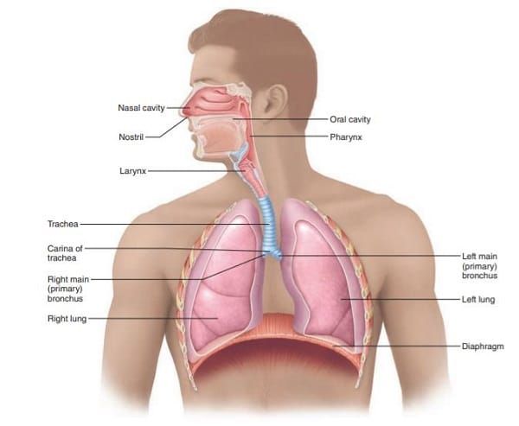
Lung Anatomy
Notes:
Upper respiratory tract :
Nasal cavity
Pharynx
Larynx
Lower respiratory tract :
Trachea
Primary bronchi
Lungs
We are going to focus mainly on the Lower respiratory tract today as this typically falls within the physiotherapy remit and are areas significant to your practise.

Slide 4
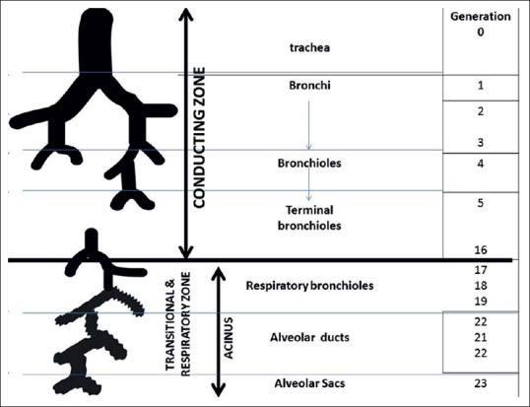
Conducting vs Respiratory zone
Conducting Zone:
Made up of the nose, pharynx, larynx , trachea, bronchi and bronchioles.
Form a continuous passageway for air to move in and out of the lungs
Respiratory zone:
Deep inside the lungs
Respiratory bronchioles, alveolar ducts and alveoli

Slide 5
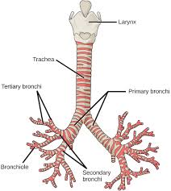
Conducting zone: Trachea
Fibrocartilaginous tube
Extends between the larynx and thorax
Divides into the primary bronchi at the carina
Blood supply : tracheal branches of inferior thyroid artery
Innervation : pulmonary plexus
Right main bronchus is much shorter than the left

Slide 6
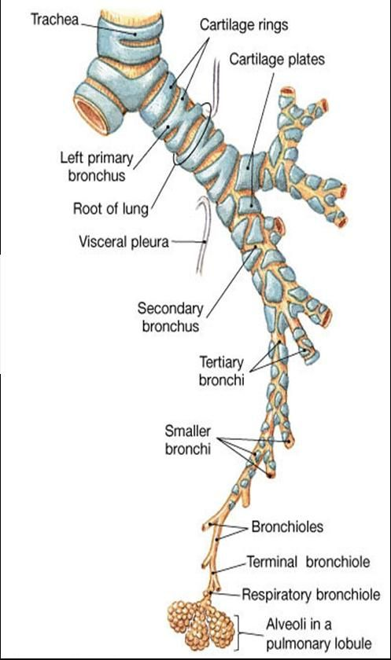
Conducting zone : bronchi and bronchioles
The first bronchi branch from the trachea (right and left main bronchus)
Branch further into the secondary bronchi (lobar bronchi)
Then tertiary bronchi (segmental bronchi)
Continue to branch until they reach the final and sixth generation of bronchi : the bronchioles
  Too small to be supported by cartilage
Notes:
The right main bronchus is more vertical, and you are therefore more likely to aspirate into the right lung.

Slide 7
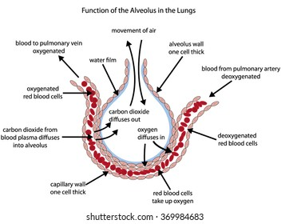
Respiratory Zones : Alveoli
Where gas exchange occurs in the lungs
Increase the surface area for gas exchange
Single layer of alveolar epithelial cells : type 1 and 2 pneumocytes
Type 1 pneumocytes cover 95% of entire surface of alveoli and are an excellent surface for gas exchange
Type 2 pneumocytes produce surfactant. This helps to reduce the effects of surface tension.
The balance of expansion and recoil determines the size of the alveoli
Lung recoil is used to describe the tendency of the alveoli to rebound after inflation
Notes:
“A cluster of grapes”
All interconnected whilst still being an independent structure

Slide 8
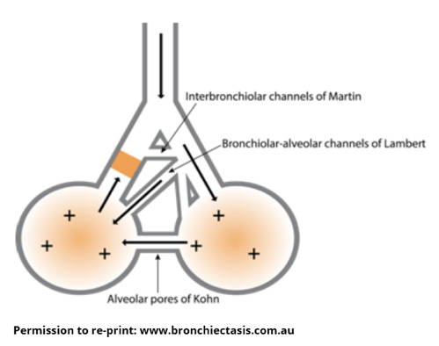
Special features of the alveoli
Thin walls : decrease the distance for diffusion
Close to the capillaries : decrease the distance for diffusion
High in number : increased surface area for diffusion
Collateral channels of ventilation: get past blockages
Interconnected : help to pull each other open

Slide 9
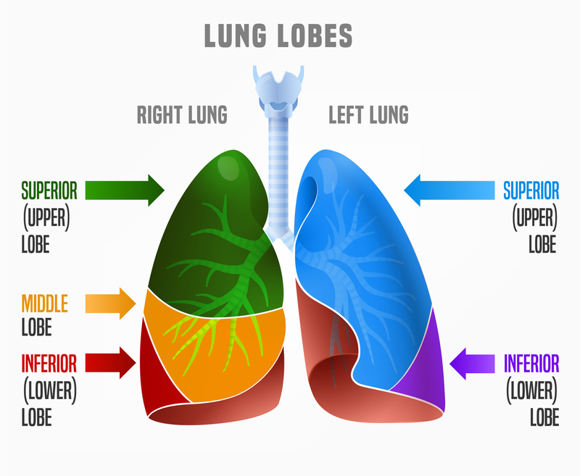
Lobes of the lung
Horizontal fissure
The right and left lung are similar but asymmetrical :
  Right lung has 3 lobes
  Left Lung has 2 lobes
Oblique fissure
The right and left lung are similar but asymmetrical :
  Right lung has 3 lobes
  Left Lung has 2 lobes
Oblique fissure

Slide 10
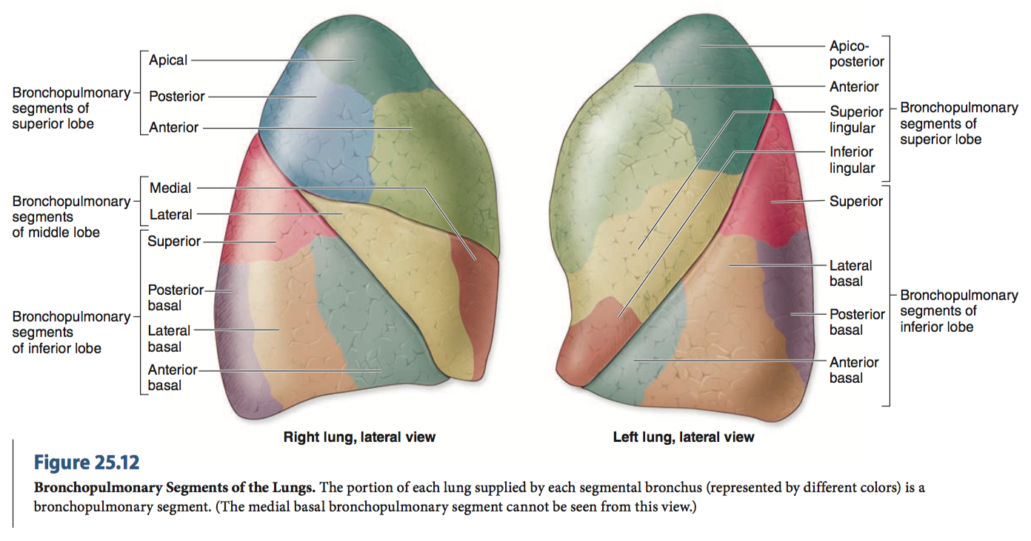
Bronchopulmonary segments
The lobes further divide into segments associated with specific bronchi

Slide 11
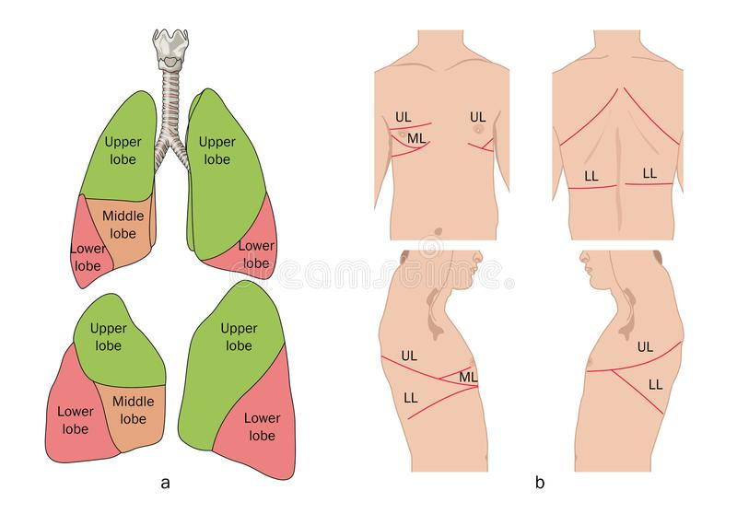
Surface mapping

Slide 12
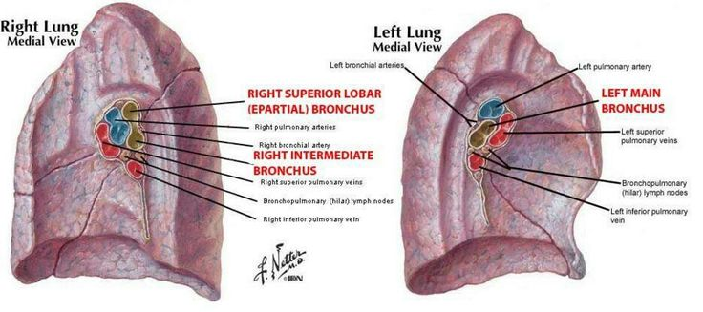
Hilum (root)
The point at which various structures enter and exit the lungs
Surrounded by the pleura.
Contains :
  Bronchi
  Pulmonary vasculature
  The phrenic nerve
  Lymphatics
  Bronchial vessels
    Pulmonary artery
    Pulmonary veins ( R and L)

Slide 13
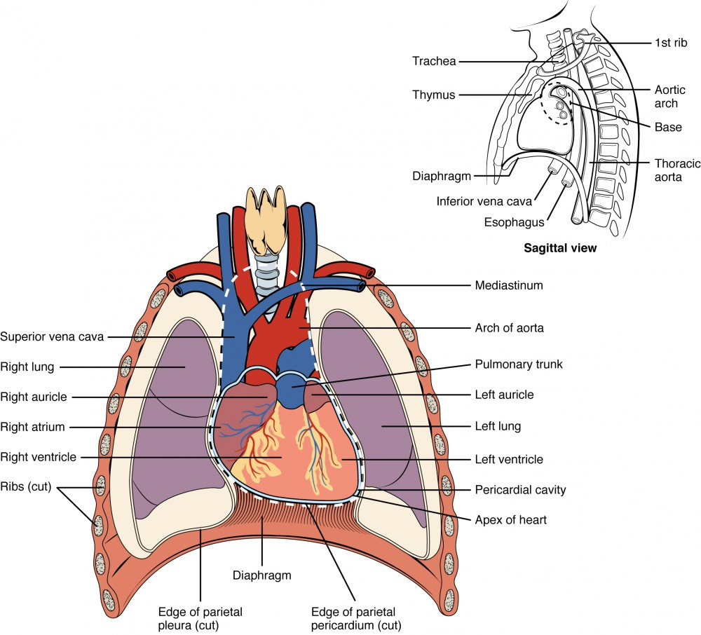
Mediastinum
A central compartment in the thoracic cavity between the pleural sacs of the lungs.
Divided into superior and inferior portions. Inferior then divides into middle and posterior portions.

Slide 14
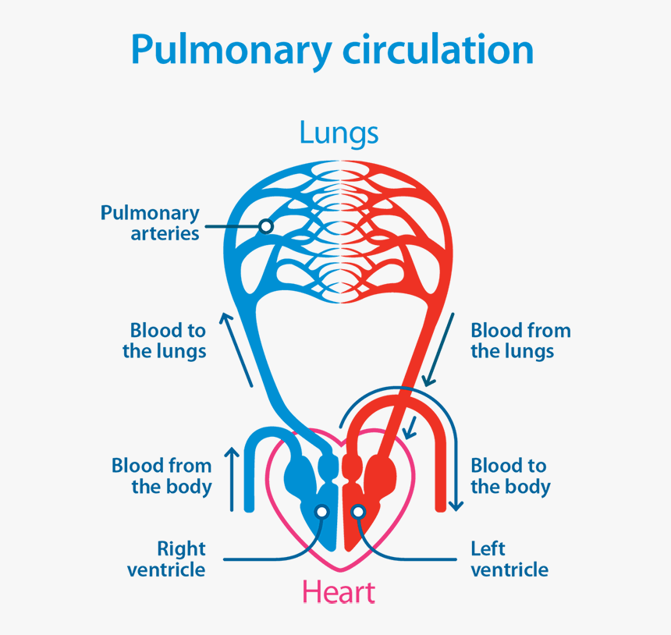
Pulmonary circulation
The pulmonary circulation receives the entirety of the cardiac output from the right heart and is a low pressure, low resistance system.
Can be divided into
  The arterial circuit
  The venous circuit
  The Lymphatics
  Bronchial circulation
Notes:
Can be divided into :
The arterial circuit :
Arises from main pulmonary artery arising from Right ventricle
Divides into a multiple vessels to form a network of small arteries, arterioles and capillaries.
The venous circuit:
Begins with the venules that drain the capillaries
Join to form smaller veins and merge to form the main pulmonary veins
Drain into the Left atrium
The Lymphatics:
Crucial role in maintaining dry alveolar membrane and prevent accumulation of tissue fluid around the pulmonary circulation
Bronchial circulation :
Supplies the lung parenchyma with oxygenated blood
~1% of cardiac output
Arises from the aorta

Slide 15
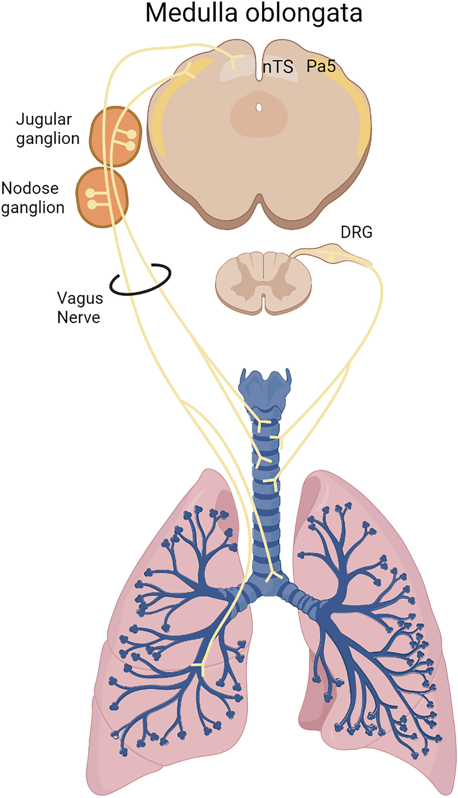
Innervation of the lungs
The lung receives innervation from 2 main sources:
  The pulmonary plexus
    A combination of parasympathetic and sympathetic nerves
  Phrenic nerve
  Parasympathetic innervation causes constriction of the bronchi, dilation of pulmonary vessels and increase gland secretions
  Sympathetic innervation causes dilation of the bronchi and constriction of the pulmonary vessels

Slide 16
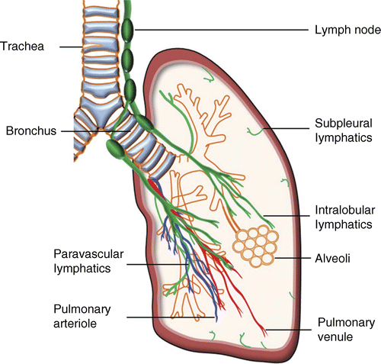
Pulmonary Lymphatic system
Maintains fluid homeostasis
Fight infections
However:
A primary cancer may lead to cancer cells being transported around the body leading to metastasis

Slide 17
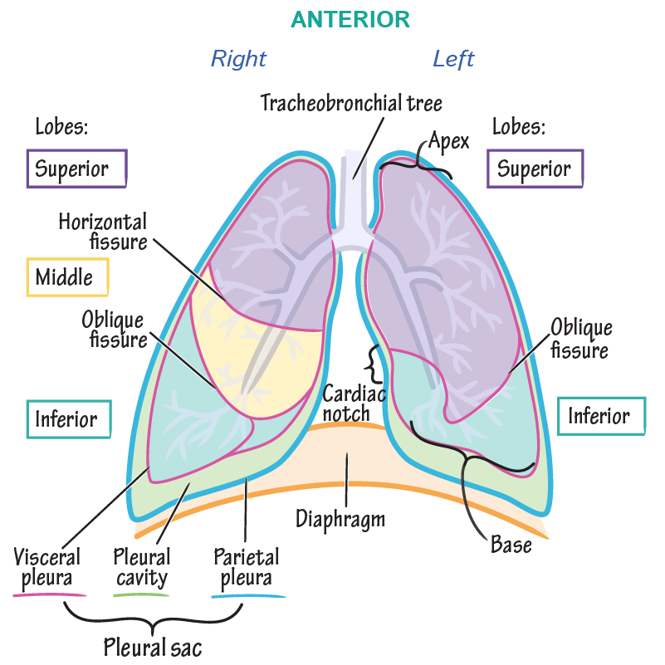
The Pleura
Parietal pleura
Visceral pleura
No anatomical connection between the right and left pleural cavities

Slide 18
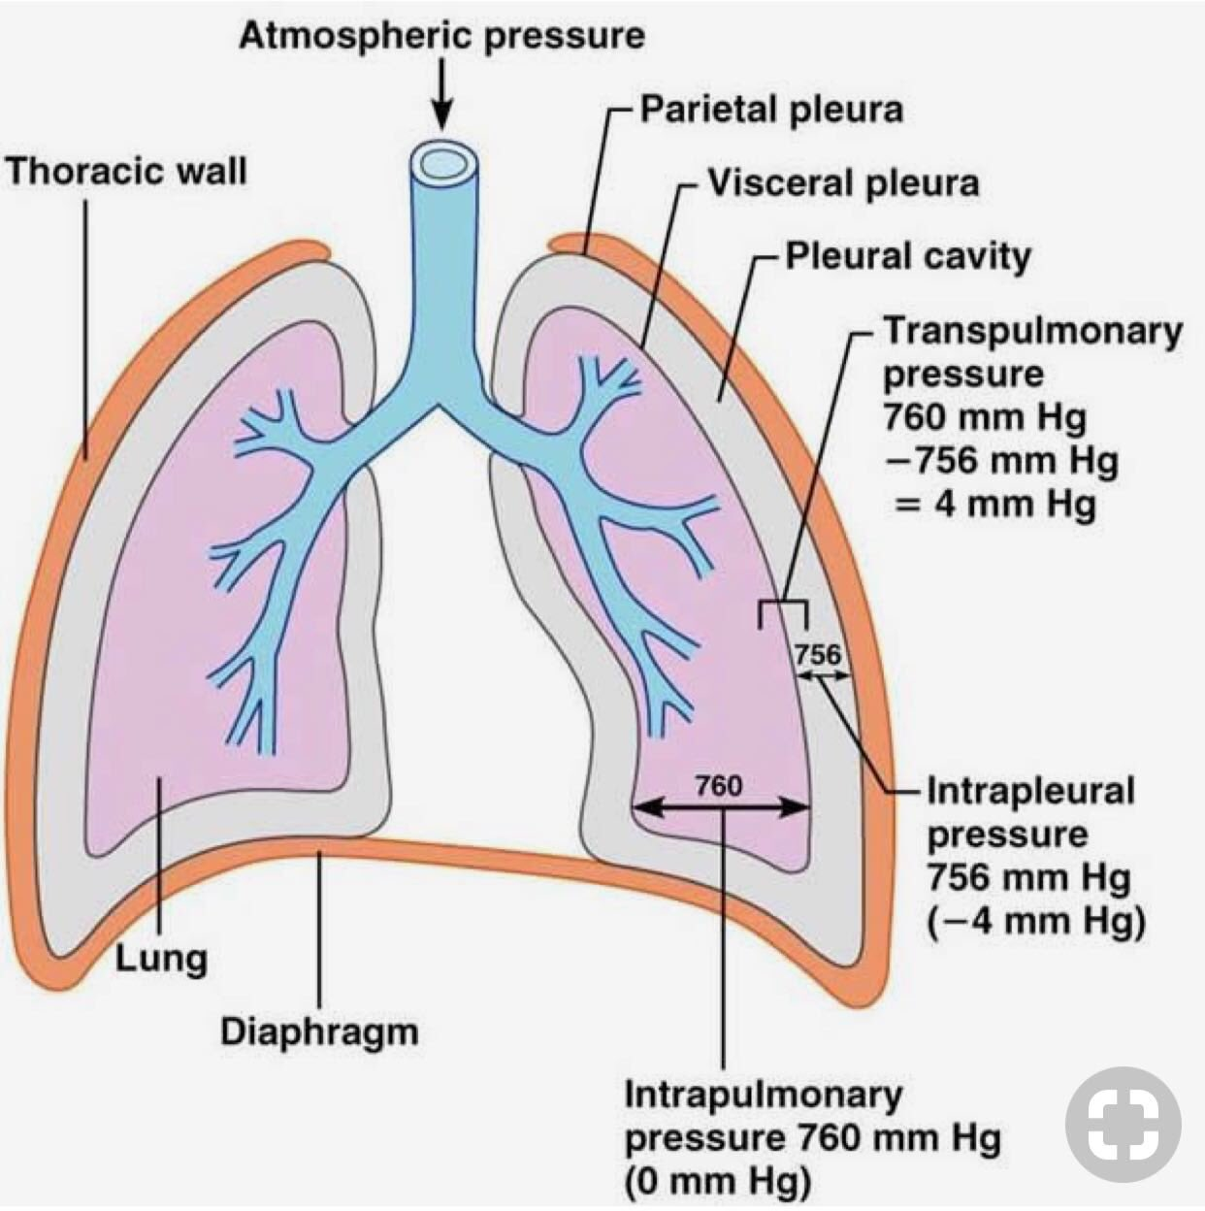
Pleural Cavity
The space between the visceral and parietal pleura.
Pleural cavity filled with small amount of serous fluid with 2 key functions:
Allows for reduced friction during respiration
Generates surface tension
Pleural recesses :
  Located posteriorly and anteriorly where the pleural cavity is not totally filled with lung parenchyma
    Costomedial recess : posterior to the sternum
    Costodiaphragmatic recess : between the diaphragmatic and costal pluera
Notes:
Pleural cavity filled with small amount of serous fluid with 2 key functions:
- allows for reduced friction during respiration
- Generates surface tension

Slide 19
Surface tension
Created by water molecules at the air-liquid interface within the alveoli
Pleural role in surface tension:
Promotes lung expansion
Prevents alveolar collapse
Improves compliance
Facilitates pressure changes
Surfactant role in surface tension:
Secreted by the type 2 alveolar cells
Reduces surface tension
Increases lung compliance
Prevents alveolar collapse
Facilitates alveolar recruitment
Notes:
Surface tension in the lungs is the inward force created by water molecules at the air-liquid interface within the alveoli1
This occurs because:
The alveoli are lined with a thin layer of fluid
Water molecules in this fluid tend to pull together due to their polar nature
This creates an inward force that reduces the surface area of the alveoli
The pleural fluid's surface tension properties have several key effects:Promotes lung expansion - The adhesive forces created by surface tension help pull the lungs outward during inspiration3
Prevents alveolar collapse - By keeping the lungs expanded, it counteracts the tendency of alveoli to collapse due to their own surface tension1
Improves compliance - The lubrication and adhesion provided by the pleural fluid increases lung compliance, making breathing easier2
Facilitates pressure changes - The fluid allows for rapid transmission of pressure changes throughout the pleural cavity during breathing

Slide 20

Pleural Pathologies
Notes:
Pleural pathologies cause issues with proper expansion and movement of the lungs
Here are a few examples of this....

Slide 21
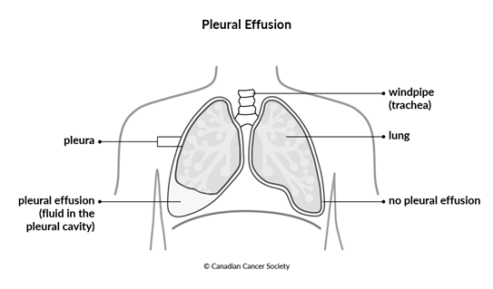
Pleural effusion
Accumulation of fluid in the pleural space
Common causes of Pleural effusion :
  Congestive heart failure
  Cancer
  Bacterial pneumonia
  Post surgery
  Pulmonary embolism
Symptoms :
  Shortness of breath
  Chest pain
  Dry cough

Slide 22
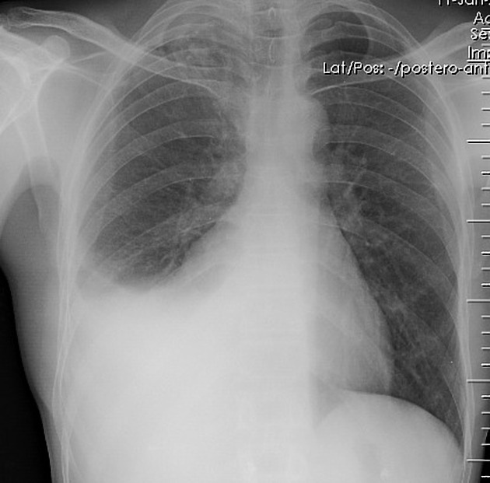
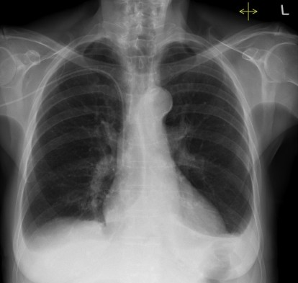
Imaging
Notes:
Image 2: Pleural effusions (no date) Radiology at St. Vincent’s University Hospital. Available at: http://www.svuhradiology.ie/case-study/pleural-effusions/ (Accessed: 17 November 2023).

Slide 23
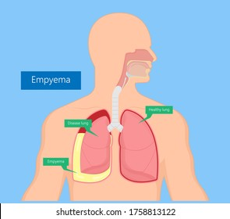
Empyema
Collection of pus in the pleural cavity
  Common causes :
    Post surgery
    Pneumonia
    Alcohol abuse
    Trauma
  Symptoms :
    Pain
    Cough with increased sputum production
    Dullness in chest wall percussion
    Palpable fremitus

Slide 24
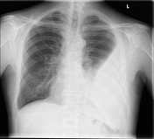
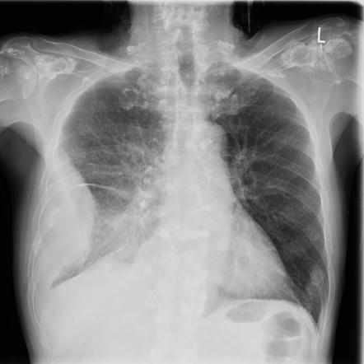
Imaging

Slide 25
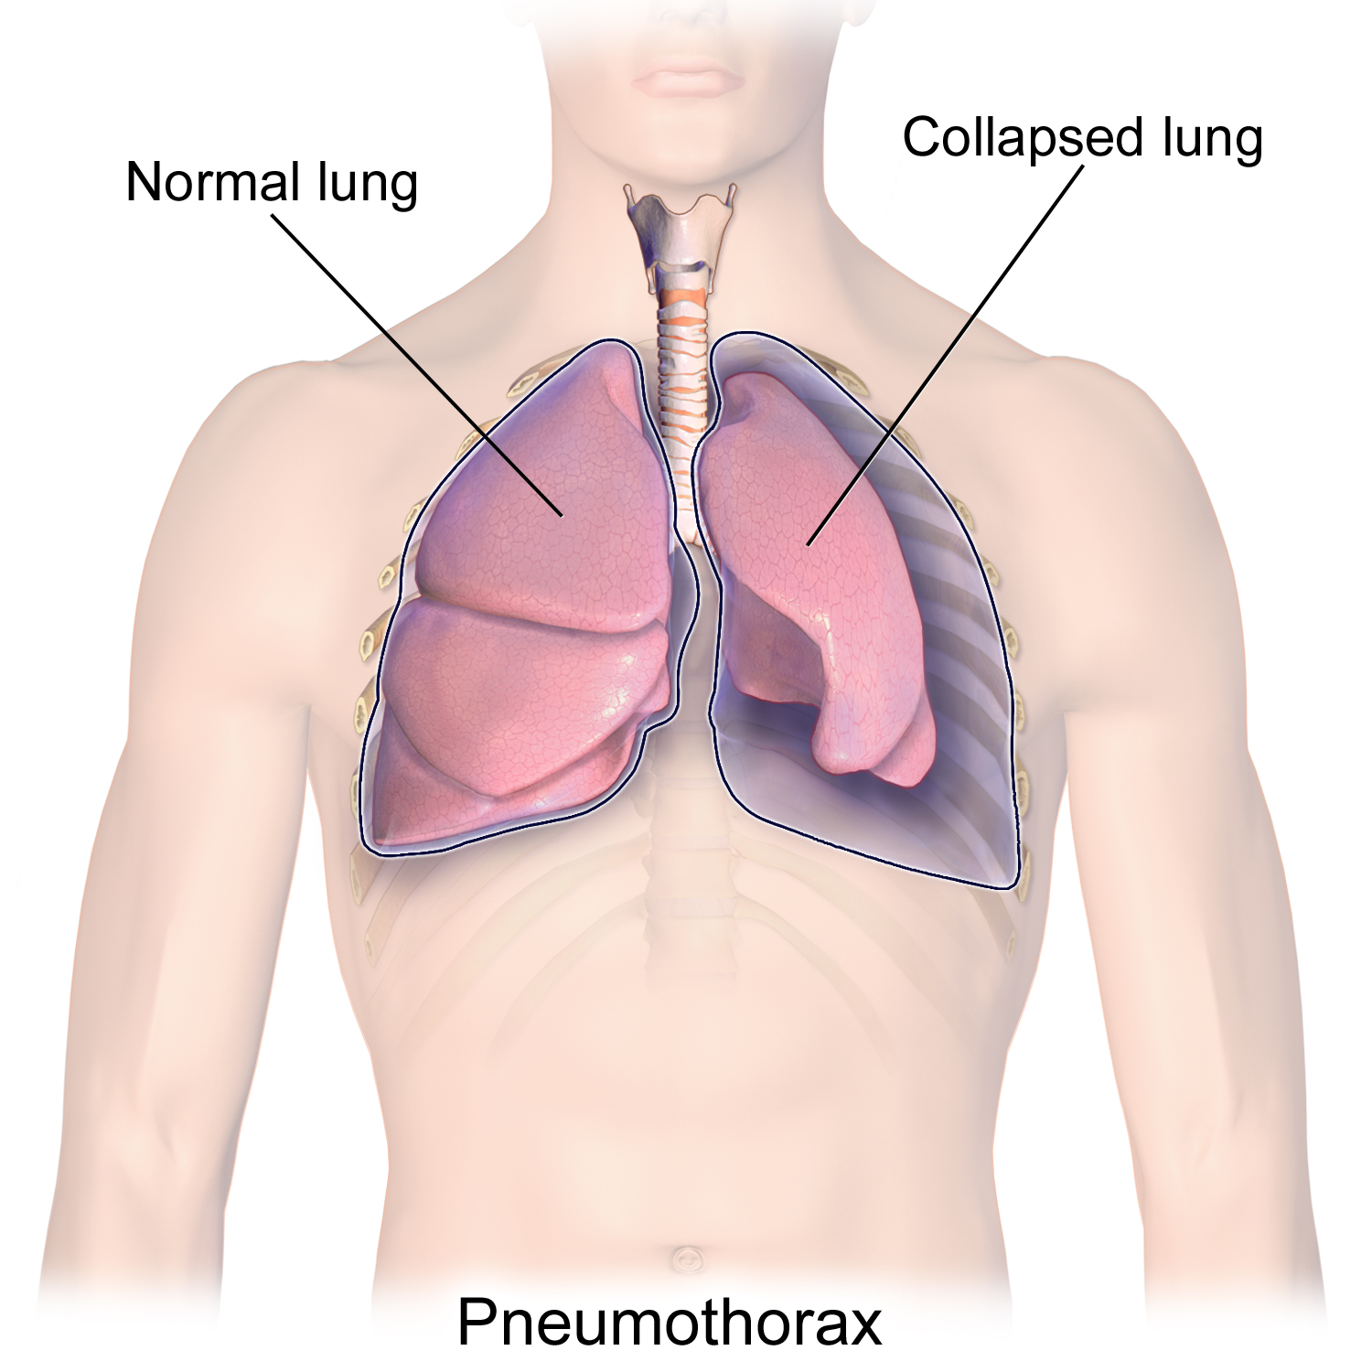
Pneumothorax
A collection of air outside the lung but within the pleural cavity. It occurs when air accumulates between the parietal and visceral pleura inside the chest. Causing the lung to collapse. Defined as tension or spontaneous.
Notes:
Tension:
The result of blunt or penetrating trauma
The leak in the visceral pleura creates a one-way valve allowing air into the thorax but not allowing it to escape.
Requires urgent decompression
Pushes the mediastinal structures away because of the increased pleural space pressure
Spontanious:
Can occur without a known eliciting event
Can occur because of underlying pathology or significant atelectasis of the lung
Normally treated with a drain
Pulls the mediastinal structures towards it.

Slide 26
Pneumothorax
TENSION :
Trauma
Leak in the visceral pleura
Urgent decompression required
Mediastinum pushed AWAY
  Increased plueral space pressure
SPONTANEOUS:
No cause / Atelectasis / pathology
Treated with a drain
Mediastinum pulled TOWARDS
Notes:
Tension:
The result of blunt or penetrating trauma
The leak in the visceral pleura creates a one-way valve allowing air into the thorax but not allowing it to escape.
Requires urgent decompression
Pushes the mediastinal structures away because of the increased pleural space pressure
Spontanious :
Can occur without eliciting event
Can pccur because of underlying pathology / significant atelectasis of lung
Normally treated with a drain
Pulls the mediastinal structures towards it

Slide 27
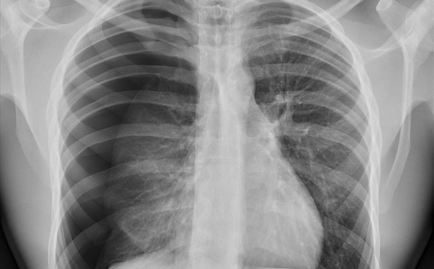
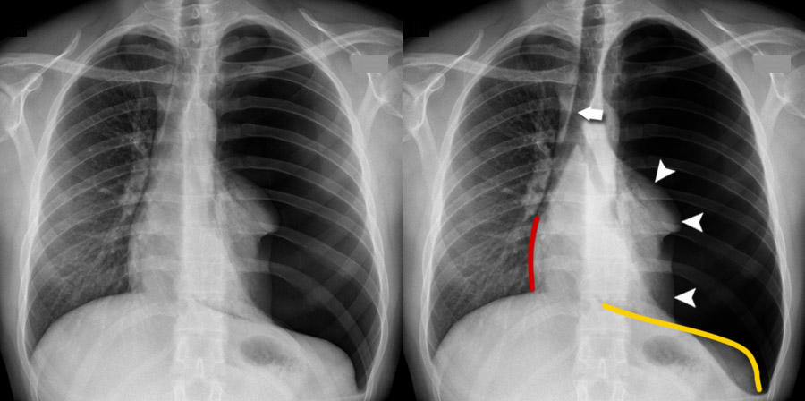
Tension VS Spontaneous

Slide 28
Key points
Lungs are made up of lobes:
  L 2 lobes
  R 3 lobes
Split into the conducting zone and the respiratory zone
Alveoli are the site of gaseous exchange
  Special features that help to support diffusion of gas in and out of blood
Pleura line the chest and the outside of the lung
  Reduce friction
  Generate surface tension
Pleural pathologies can prevent expansion of the lung or cause collapse of the lung
Tension pneumothorax : moves away
Spontaneous pneumothorax: Pulls towards

Slide 29
References
Patwa, A. and Shah, A. (2015) ‘Anatomy and physiology of respiratory system relevant to anaesthesia’, Indian Journal of Anaesthesia, 59(9), p. 533. doi:10.4103/0019-5049.165849.
Stump, B. et al. (2017) ‘Lymphatic changes in respiratory diseases: More than just remodeling of the lung?’, American Journal of Respiratory Cell and Molecular Biology, 57(3), pp. 272–279. doi:10.1165/rcmb.2016-0290tr.
Anan, R.A. (2022) Empyema vs pleural effusion: Radiology reference article, Radiopaedia. Available at: https://radiopaedia.org/articles/empyema-vs-pleural-effusion-2 (Accessed: 17 November 2023).
Garvia V, Paul M. Empyema. [Updated 2023 Aug 7]. In: StatPearls [Internet]. Treasure Island (FL): StatPearls Publishing; 2023 Jan-. Available from: https://www.ncbi.nlm.nih.gov/books/NBK459237/
Mahabadi N, Goizueta AA, Bordoni B. Anatomy, Thorax, Lung Pleura And Mediastinum. 2022 Oct 17. In: StatPearls [Internet]. Treasure Island (FL): StatPearls Publishing; 2023 Jan–. PMID: 30085590.
Chaudhry R, Bordoni B. Anatomy, Thorax, Lungs. 2023 Jul 24. In: StatPearls [Internet]. Treasure Island (FL): StatPearls Publishing; 2023 Jan–. PMID: 29262068.
Bustamante-Marin XM, Ostrowski LE. Cilia and Mucociliary Clearance. Cold Spring Harb Perspect Biol. 2017 Apr 3;9(4):a028241. doi: 10.1101/cshperspect.a028241. PMID: 27864314; PMCID: PMC5378048.
McKnight CL, Burns B. Pneumothorax. [Updated 2023 Feb 15]. In: StatPearls [Internet]. Treasure Island (FL): StatPearls Publishing; 2023 Jan-. Available from: https://www.ncbi.nlm.nih.gov/books/NBK441885/
Rad, A. (2023) Trachea, Kenhub. Available at: https://www.kenhub.com/en/library/anatomy/the-trachea (Accessed: 17 November 2023).
Jany B, Welte T. Pleural Effusion in Adults-Etiology, Diagnosis, and Treatment. Dtsch Arztebl Int. 2019 May 24;116(21):377-386. doi: 10.3238/arztebl.2019.0377. PMID: 31315808; PMCID: PMC6647819.

